Slide 1

DriverPass System Analysis
Payton Adamson
Notes:
[No speaker notes required for this slide.]

Slide 2

System Requirements
Functional Requirements:
The system shall be accessed from anywhere, and will allow users and administration to log in with proper credentials.
The system shall provide students a learning web platform that is organized and provides educational content created or provided by DriverPass.
Nonfunctional Requirements:
Requested for the information to be stored and web-based by a cloud service, to refrain from storing backups and handle security in-house.
The system will have to be updated regularly, or as needed when DMV rules or regulations are changed or updated.
Notes:
DrivePass wants to capitalize on the potential market for beginner drivers, and make a system to allow users to take online classes and take practice tests in a general sense, as well as other, more precise, traits, such as being able to access data from anywhere, offline and online. To make this available for users, we need to allow people to access and register anywhere, allowing their information to be attached to their account so they can purchase packages for their own purposes; weather to study, schedule appointments, or take tests. As for nonfunctional, the site needs to keep all the proper information attached to each account, easily backing up and keeping logs, that way the information is updated the next time the user logs in or uses the site elsewhere. As well as continuing to update, that way the information relayed is not incorrect or not applicable for real-world use.

Slide 3
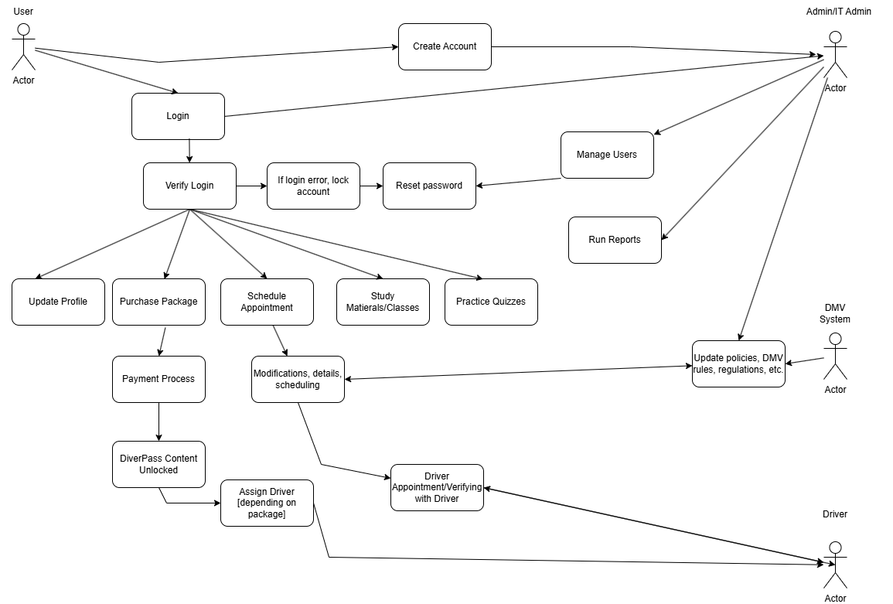
Use Case Diagram
Notes:
When thinking about DriverPass as an application, there are a few pieces to be used in the program. The customer, the main user, and the supporting actors, Administration, DMV System, and Drivers themselves. The customer needs to be able to access features like creating their account and accessing their information, purchase products applicable to them, and accessing what information they need that applies to their needs. Administration will need to be able to support and help in the sense of if there are any issues, such as forgetting information, or running reports incase there are issues or anything that needs to be updated. The DMV System will continually update their guidelines, that way all the proper information and education is up-to-date. Drivers will need to be able to access their appointments to show up on time, and teach properly.

Slide 4
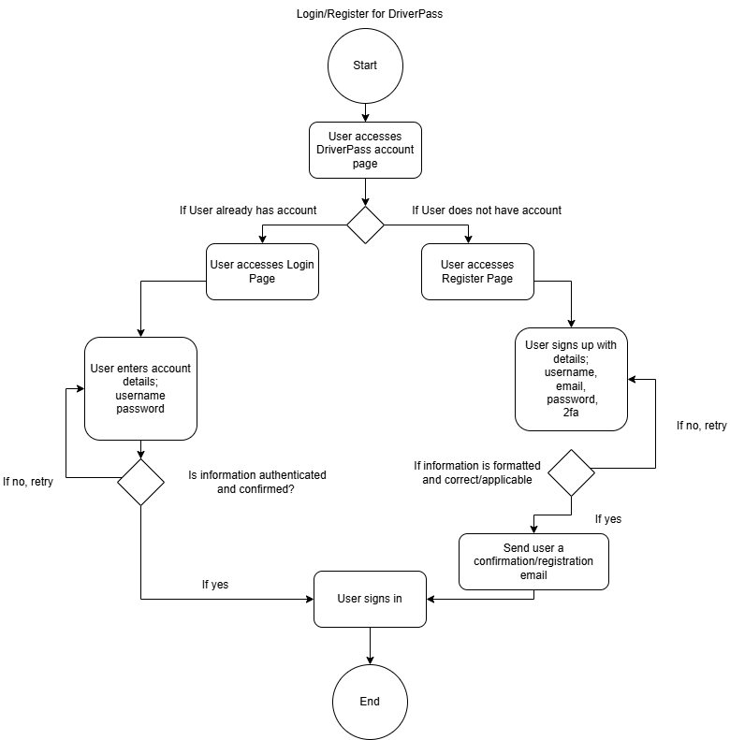
Activity Diagram
Notes:
The activity diagram breaks down the user login/register use case. First, the user goes to the DriverPass website and clicks a link to access their account. If the user doesn’t have an account, they’d click register. Otherwise, they simply click login. If the user clicks register, they need to enter all the necessary information, like their name, email, address, etc… The user would then receive a registration email. If the user clicks login, they will enter their username and password. If the login credentials aren’t authorized, they’d have to reenter their credentials. Otherwise, the user is logged in and can manage their account.
DriverPass requires a simple way for users to create an account, and they also need to be able to login to save their information. This requires authorization so that hackers can’t easily get into user accounts.

Slide 5
Security
Registered user must authenticate their email address
Case-sensitive passwords chosen by each individual
Users require a password to login
Authorization process stops “brute force” so hackers can’t easily login to user accounts
Website uses HTTPS rather than HTTP, so that sensitive information is sent encrypted
Notes:
Security features are extremely important for a program that allows users to purchase anything, to support this, we can add is having users register their email when the create an account. This would help stop bot accounts from being created, but it does add one extra step for the user. This way though, every user of the program has their own unique log-in. As is standard nowadays, users will require a password to access their account. This stops anyone from logging in as another user without the right password. Next, we can develop a limit to incorrect login attempts. For example, if a user doesn’t use the right password in three attempts, their account is locked for some amount of time, or until they call in. This would prevent “brute force” attacks from hackers, where they use a script to guess the password, but it usually takes thousands of attempts to get it. If a person forgets their password, they will be prompted to change it via a link on the login window where IT administrators can initiate the change on their behalf or utilize the self-service link. Lastly, the website will utilize HTTPS over HTTP. This way, when sensitive data like credit card numbers and client information is sent it is encrypted. This makes is more difficult for a hacker to steal data.

Slide 6
System Limitations
Customers need to have online internet access to usually access the site, or to update information.
Customers in certain regions may have slower access to the website.
Some client devices may not be able to open the website.
Time, budget, and resources
Notes:
For DriverPass, we mainly are against time, with only a few months to develop a program that is applicable and running for others to use. In hand, the budget and resources we have, with such a small team this will be severely detrimental to a fast progressive effort to make a program. As well as, what we can use in the hardware subject, the budget will dictate what we can use as a ground-basis, and what resources the customer base will have access to, like certain browsers that the system will not be implemented on. As well as allowing others to use it in all locations, a DriverPass partner or system will need to implemented in the areas it can be serviced towards. All-in-all, this can be developed with time, but for the initial, we will be focusing on these system limitations.

